Slide 1
Using these slides
This slide deck is intended to support you in talking about Evolve
Take what is relevant to your talk and delete the rest – this slide deck was not designed to be presented in it’s entirety
You can add your own slides by clicking ‘new slide’
To highlight specific recommendations relevant to your talk visit https://evolve.edu.au/recommendations
If you feel like something is missing or would be helpful let us know.
It is also helpful to see what other physicians have presented on. Visit https://evolve.edu.au/evolve-research to view other presentations
To share your presentation, provide feedback or request support email evolve@racp.edu.au

Slide 2
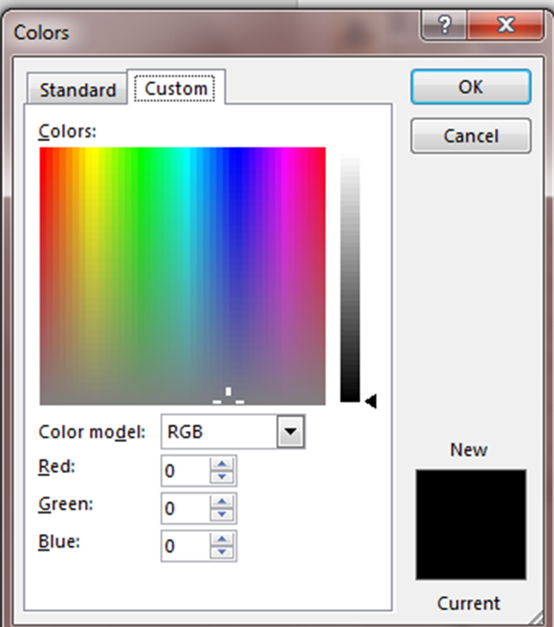
Evolve Colours
We encourage you to use the Evolve colours where you want to add colour e.g. subheadings
Colour | Red | Green | Blue
Heading | 0 | 66 | 123
Sub Heading | 0 | 128 | 124
Bold Words | 77 | 132 | 159
Extra Colour | 232 | 187 | 100
Extra Colour | 26 | 64 | 113
Extra Colour | 112 | 104 | 91
Extra Colour | 228 | 198 | 135

Slide 3

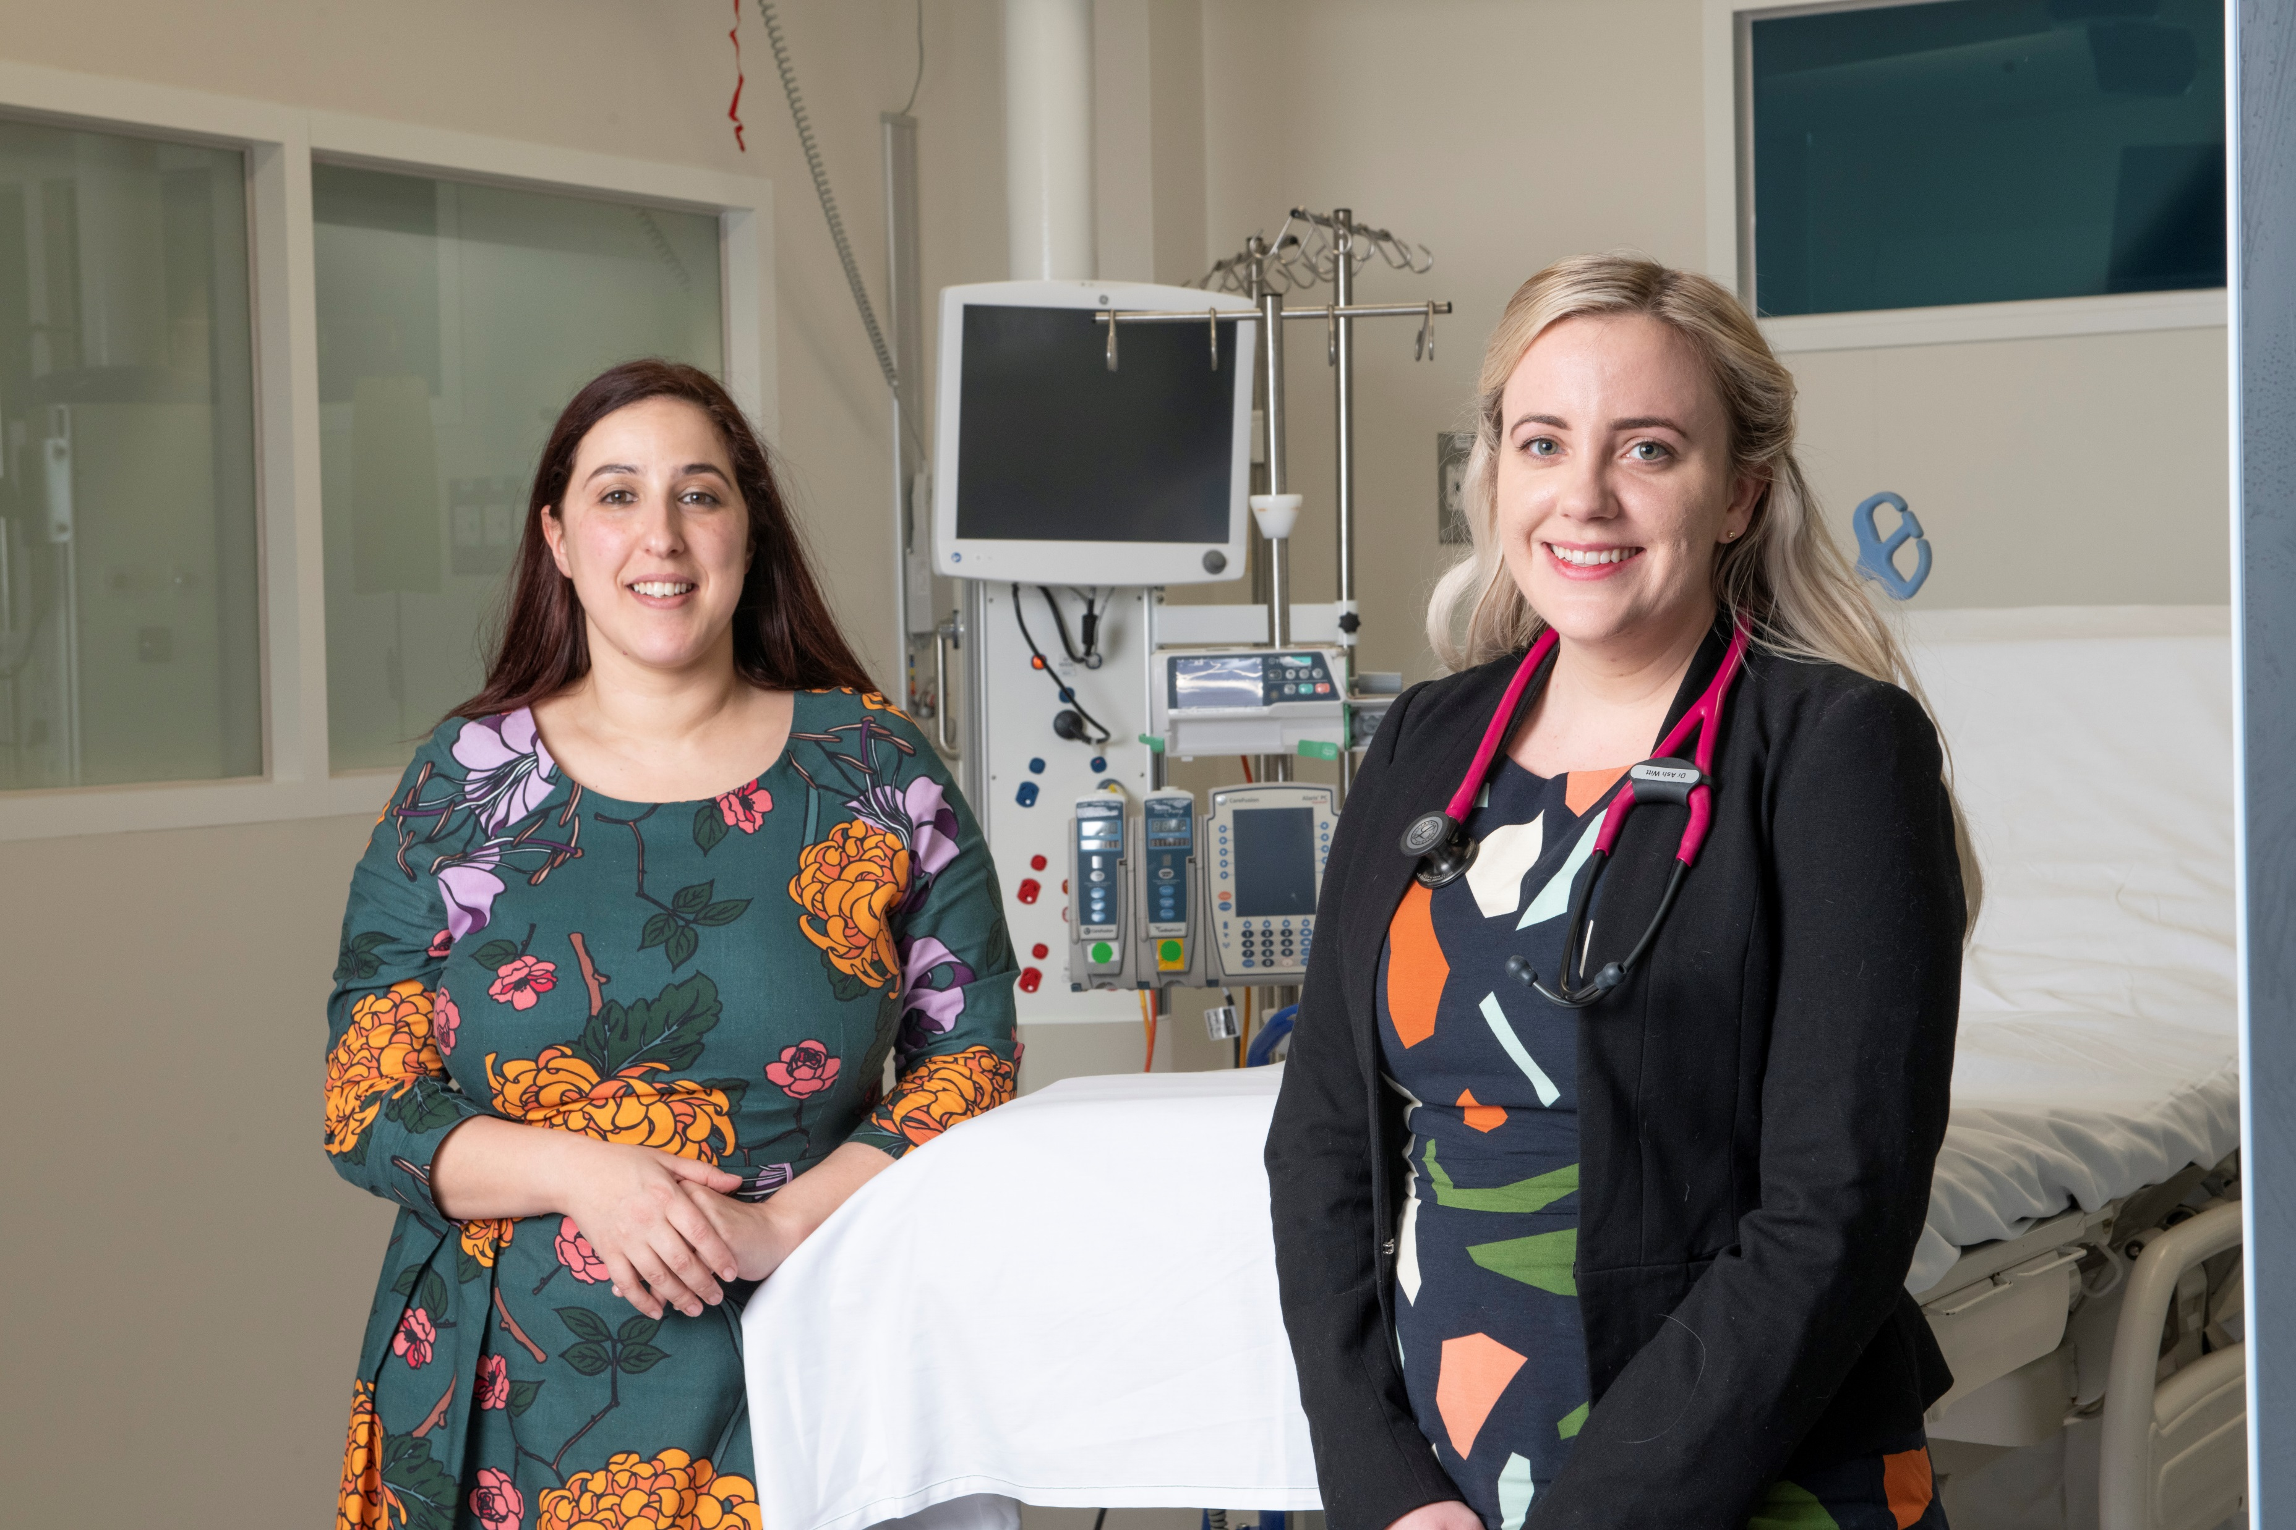
Please only use these images for Evolve presentations

Slide 4


Please only use these images for Evolve presentations

Slide 6
Evolve

Slide 7
What is Evolve?
As part of a global movement, Evolve is a flagship initiative led by physicians and the Royal Australasian College of Physicians (RACP) to drive high-value, high-quality care in Australia and New Zealand.
The RACP through Evolve is a founding member of Choosing Wisely in Australia and New Zealand, with all Evolve ‘Top-Five’ recommendations part of the Choosing Wisely campaign.
Evolve works with specialties to identify their ‘Top-Five’ clinical practices that, in particular circumstances, may:
  be overused,
  provide little or no benefit, or
  cause unnecessary harm.

Slide 8
How common is low-value care?
High rates of low-value care are well documented in wealthy countries, across a wide range of specialties. (Brownlee et al. 2017)
30-50% of trials of established practices show little to no benefit. (Prassad et. 2011)
Worldwide, overuse of individual services can be as high as 89%. (Brownlee et al. 2017)

Slide 9
Examples of low-value care in specialist practice
X-rays or other imaging for acute low-back pain without red flags
Using medicines when a safer, more effective non-drug strategy available
Antibiotics for uncomplicated upper respiratory tract infections
Long-term use of proton pump inhibitors (PPIs) without seeking to cut down to lowest-effective dose or ceasing therapy
Abdominal or chest X-rays for diagnosis of non-specific abdominal pain or asthma in children
Testosterone therapy unless evidence of proven deficiency

Slide 10
What is high-value care?
Ensuring patients receive the tests, treatments or procedures they need, and not those they don’t.
Using clinical reasoning to enable patient centred care.
Engaging in joint-decision making.

Slide 11
What does Evolve mean for physicians?
Evolve ‘Top-Five’ recommendations on low-value practices are developed through a rigorous, peer-reviewed process; led by clinical experts, informed by evidence and guided by consultation.
Evolve enables physicians to:
safely and responsibly phase out low-value tests, treatments and procedures, where appropriate
enhance the safety and quality of healthcare
provide high-value care to patients based on evidence and expertise, and
influence the best use of health resources, reducing wasted expenditure and the carbon footprint of the healthcare system
Notes:
Ultimately Evolve is aiming drive high-value, patient centred care that to improves patient safety and patient outcomes.
We want to provide our trainees and fellows with the latest evidence of best practice and empower them to make changes to safely and responsibly phase out low-value tests, treatments and procedures. We want to ensure patients receive the test, treatment and procedure they need, and not those they don’t. This will free up resources for high value care.

Slide 12
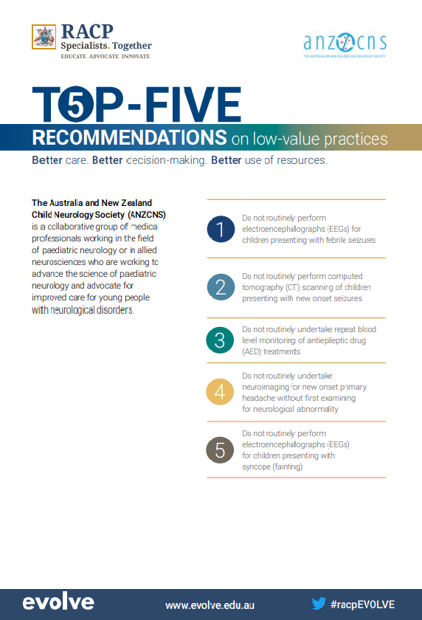
Evolve Top-5 Recommendations
Developing Evolve Recommendations
Evolve is a partnership between the RACP and specialties. The movement provides a trusted process for each Specialty to remain up-to-date with the latest evidence. The development of Evolve ‘Top-Five’ recommendations is:
Fellow-led, collaborative, evidence and consensus-based
flexible – guided by agreed criteria, the process allows for adaptability in approach and pathways tailored to Specialties, and
transparent.
Notes:
Information is current as at 9 October 2019 – please confirm with evolve@racp.edu.au for most recent information

Slide 13
Developing Evolve Recommendations
1. Identify
Identify a long list of low-value care through a rigorous, peer-review process; led by clinical experts, informed by evidence and guided by consultation.
2. Refine:
Refine the list against the following guiding questions in consultation to identify the ‘Top-5’ priority practices:
3. Finalise:
Finalise the ‘Top-5’ recs on low value practices.
4. Share
Share the ‘Top-5’ recs with Choosing Wisely.
Physicians lead implementation of Evolve recs in their practice.
5. Implement
6. Review
Every few years review the Top-5 recs to ensure they remain relevant
Guiding Questions:
Is this practice overused, of little or no benefit, or may cause unnecessary harm?
Is this practice undertaken mainly by the specialty?
Is this practice undertaken with noticeable frequency in the specialty or the health system?
Notes:
Information is current as at 9 October 2019 – please confirm with evolve@racp.edu.au for most recent information

Slide 14
Evolve Top-5 Recommendations
There are currently 27 Evolve Top 5 Recommendations Lists available, with more in development. These are reviewed every few years.
Recently released Evolve Top 5 Lists include:
Australian and New Zealand Society of Nephrology
Australasian Chapter of Addiction Medicine
Thoracic Society of Australia and New Zealand – Adult
Evolve Top 5 Lists currently in development, include:
Australia and New Zealand Society for Blood Transfusion
Australasian Society of Clinical and Experimental Pharmacologists and Toxicologists (revision)
Notes:
Information is current as at 16 February 2022 – please confirm with evolve@racp.edu.au for most recent information

Slide 15
Clinical decision making
Considering individual patients
Evolve encourages shared decision-making with a patient and/or carer and reflection on when a clinical practice may not be of benefit to a patient.
Before making a clinical decision, Evolve encourages physicians to ask themselves:
  Should I undertake this practice for this patient?
  Do the risks to the patient outweigh the benefits?
  Does the patient really need this test, treatment or procedure?
  Does the Evolve recommendation change my clinical-decision making?
  Is there a simpler, safer option?

Slide 16
Reflecting on clinical practice
The RACP is encouraging physicians to implement these recommendations in their work and health service.
Reflecting on clinical practice
Evolve encourages physicians to consider:
  Are these low-value practices that I do?
  Are these low-value practices that I see happening?
  Are there systems, processes or expectations that encourage or drive these low-value practices in my health service?

Slide 17
What influences clinical decisions?
Everyday clinical decision-making is largely intuitive, guided by our mental scripts or mindlines.
These are shaped by:
  Medical training
  Personal experience
  Peer opinion
  Professional identity
  Social norms
And cognitive biases: mental rules of thumb or thinking shortcuts.
Gabbay and le May, (British Journal of General Practice 2016)

Slide 18
Recommendation limitations
“We know we should eat more vegetables and exercise more, but it doesn’t mean we do. In medicine, as in everyday life, there is a gap between what we know and what we do.”
A/Prof Peter Bragge
Healthcare Quality Improvement (QI) at Behaviour Works
Monash University

Slide 19
Cognitive biases and low-value care
“We need to realise we’re humans. Sometimes we’re not always as rational as we think we are or should be. Humans are predictably irrational. It’s not because we’re obstinate or stupid, it’s just that we have a need to think in a certain way that gets us through our daily busy lives with a minimum of mistakes.”
A/Prof Ian Scott
Director of Medicine and Clinical Epidemiology
Princess Alexandra Hospital, Brisbane

Slide 20
Cognitive biases and low-value care
“Because rapid, high-volume clinical decision making is part of the everyday routine of physicians, and requires combining and synthesising diverse data and complex trade-offs between benefits and risks, such heuristics are probably important. These mostly unconscious short-cuts often lead to accurate results, but can also be dysfunctional and lead to skewed judgments.”
Saini, Garcia-Armesto, Klemperer et al. (The Lancet, 2017)

Slide 21
Examples of cognitive bias in medicine
Commission bias: Feeling the need to do something rather than nothing, even when watchful waiting may be the best course of action.
Impact bias: The tendency to overestimate the benefits and underestimate the harms of a clinical intervention.
Ambiguity (uncertainty) bias: Inclines clinicians to act simply to reassure or assuage a patient or peer.
Attribution bias (illusion of control): Favourable outcomes are attributed to an intervention and confidence in it boosted.
Availability bias: Emotionally charged/vivid cases stick in our minds, regardless of outcome, making them seem more important than alternatives.
(Scott et al. 2017)

Slide 22
Examples of cognitive bias in medicine
Representativeness (extrapolation) bias: Evidence of benefit in a small patient sample encourages clinicians to expect similar benefits more widely.
Endowment effects & default (status quo) bias: Extra value is placed by clinician/patient on a long-standing form of care about to withdrawn.
Sunken cost (vested interest) bias: Clinicians may persist with a form of care because they have invested considerable time/money/effort in it.
Group biases: Decision-making skewed by the need for affirmation and a sense of belonging. Leads to groupthink, bandwagon effect, etc., often fuelled by influential individuals. Dissent discouraged or dismissed.
(Scott et al. 2017)

Slide 23
Reducing low-value care
Difficult conversations
Reducing low-value care may mean you need to have difficult conversations. RACP has developed three training resources, which provide examples of how to include the Evolve Top-5 Recommendations in difficult conversations between:
  a patient and a Physician
  a carer and a Physician
  an Advanced Trainee and a Fellow

Slide 24
Increasing high-value care
Identify, raise awareness of root causes of low-value care:
  What do we do now? Why?
  How can we make it easier to do the right thing?
  How can we make it harder to do the wrong thing?
Encourage mindful medicine. Set aside time & space to pause, reflect & discuss
Look for opportunities to promote Evolve recommendations & philosophy (e.g. Grand Rounds, workshops, role-plays, etc.)

Slide 25
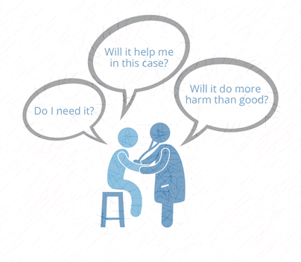
Increasing high-value care
Without blame, be open to questioning—yourself and others
Allow for uncertainty. It’s OK not to know everything
Senior doctors, become role models:
  Encourage reflection and self-awareness
  Encourage trainees and new doctors to ask questions
  Incorporate communications skills into training
Invite other professionals to help (e.g. nurses, GPs, pharmacists, allied health workers, etc.)

Slide 26
Increasing high-value care
Consider building Evolve lists into IT systems (i.e. electronic decision-support, orders, & procedures)
Make Evolve recommendations a routine part of handover conversations
Engage patients and (for paediatricians) parents in shared decision-making, including acceptable risks.

Slide 27
Increasing high-value care
Cognitive huddles and autopsies: Case studies of low-value care, presented in a ‘huddle’ or closed group.
Narratives of patient harm coupled with examination of wrong reasoning (i.e. teachable moments).
Value-of-care considerations included in clinical assessments. Detail the perceived benefits, harms and costs in management plans.
Work with patients to define acceptable levels of risk associated with from withholding intervention.

Slide 28
How physicians can be involved with Evolve
Visit the Evolve website and get to know their Specialties Top 5 Recommendations
Be a part of developing your Specialties Top-5 Recommendations
Join the Evolve Policy Reference Group and help shape and drive the Evolve initiative
Make Evolve recommendations a routine part of clinical handovers
Build your skills to enable them to participate in joint decision making with their patients, or have difficult discussions with their colleagues or supervisor
Include Evolve in education sessions like grand rounds, workshops, clinical case reviews, team meetings and more
Conduct clinical audits and feedback on an Evolve recommendation
Engage hospital management in implementing the recommendations across the health service
Discuss the recommendations with referring doctors and your multidisciplinary care team
Undertake research on Evolve and implementation of Evolve recommendations

Slide 29
How physicians can be involved with Evolve
Visit the Evolve website and get to know their Specialties Top 5 Recommendations
Be a part of developing your Specialties Top-5 Recommendations
Join the Evolve Policy Reference Group and help shape and drive the Evolve initiative
Make Evolve recommendations a routine part of clinical handovers
Build your skills to enable them to participate in joint decision making with their patients, or have difficult discussions with their colleagues or supervisor
Include Evolve in education sessions like grand rounds, workshops, clinical case reviews, team meetings and more
Conduct clinical audits and feedback on an Evolve recommendation
Engage hospital management in implementing the recommendations across the health service
Discuss the recommendations with referring doctors and your multidisciplinary care team
Undertake research on Evolve and implementation of Evolve recommendations
Don’t forget you may be able to claim some of your Evolve activities as CPD. Check against the MyCPD Framework

Slide 30
Evolve Research
  RACP encourages its Advanced Trainees and Fellows to develop and conduct research projects on specific Evolve recommendations as part of specialty training.
  Outcomes from these projects can be:
    Presented at conferences or published in journals
    Adapted across health services and specialties
    Used as ongoing references or resources
    A career development opportunity
    RACP has included Evolve implementation activities, including research, in:
      CPD Quality & Safety Training Modules
      Supervisor Training – held at Annual Specialty Society Meetings

Slide 31
  Find out more:
www.evolve.edu.au
Get in touch:
evolve@racp.edu.au
Talk about it:
@TheRACP
#racpEvolve

